Slide 1



MSCA and RAISE Doctoral Networks 2026:
Webinar about Researcher Education Network
June 10th, 2026, 10:00-11:30
ArCHe –
some insights from setting up and running a
HORIZON MSCA Doctoral network
Almut Schülke, Museum of Cultural History, University of Oslo

Slide 2
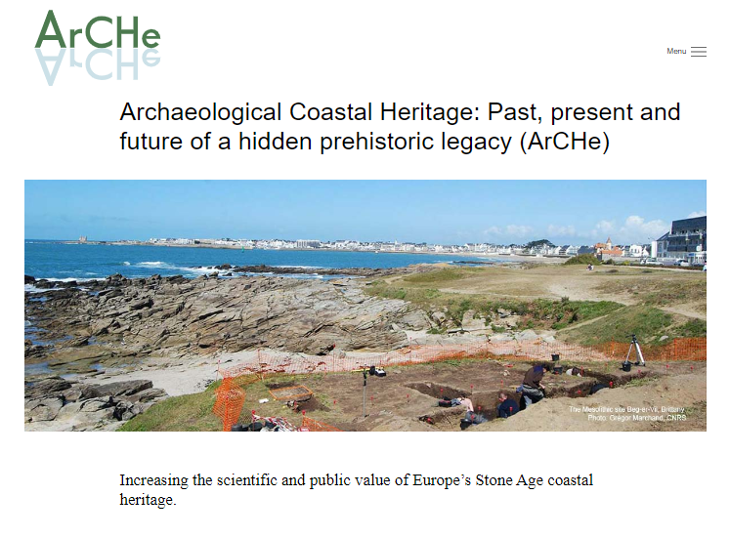


HORIZON MSCA Doctoral network
101119258 – ArCHe – HORIZON-MSCA-20220DN-01
What?
2.737.416,60 €
10 individual PhD-projects
an encompassing Joint Training Programme including academic and non-academic secondments
Who?
Coordinator: University of Oslo, Museum of Cultural History
Project Coordinator (Leader): Almut Schülke
6 Beneficiaries - housing the ten PhD-students
9 Associated partners - providing secondments/internships, (practical) training, co-supervision
When?
Project period: 01.01.2024 – 31.12.2027
www.arche.uio.no

Slide 3
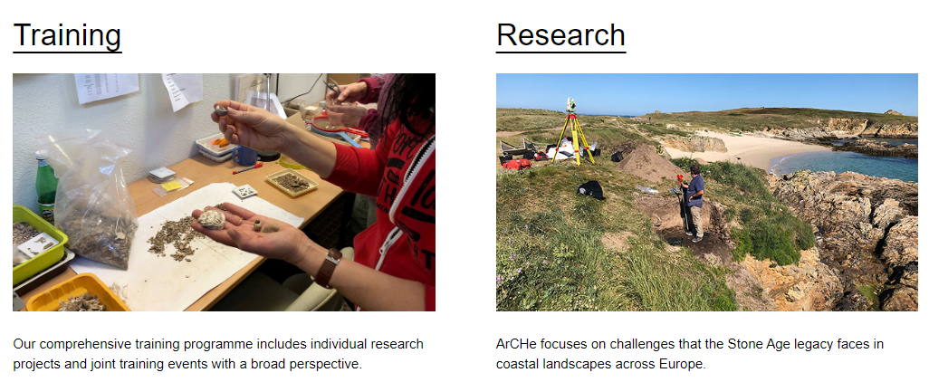
Archaeological Coastal Heritage:
Past, present and future of a hidden prehistoric legacy
Photos: Almut Schülke
Trains 10 doctoral candidates (DCs) in studying Stone Age hunter-fisher-gatherer remains (c. 12.000 – 2000 BC) in coastal areas across Europe in an international, interdisciplinary and intersectoral perspective
Past – present – future approach
Develops best practices of dealing with this vulnerable legacy for a sustainable future
Has a comparative/interregional perspective
Bridges humanities, life sciences, earth sciences and social sciences
www.arche.uio.no

Slide 4
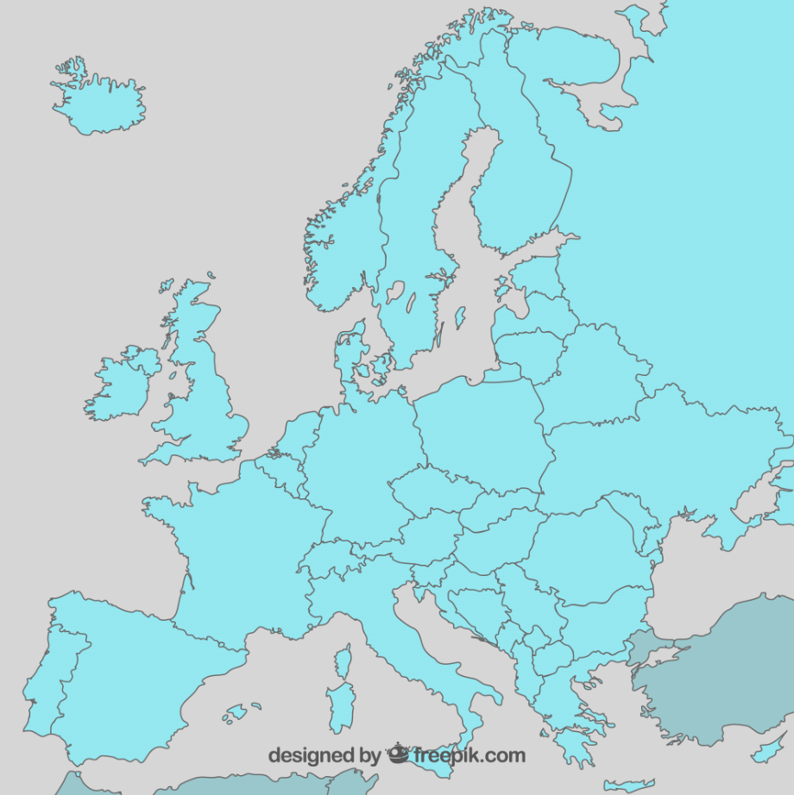
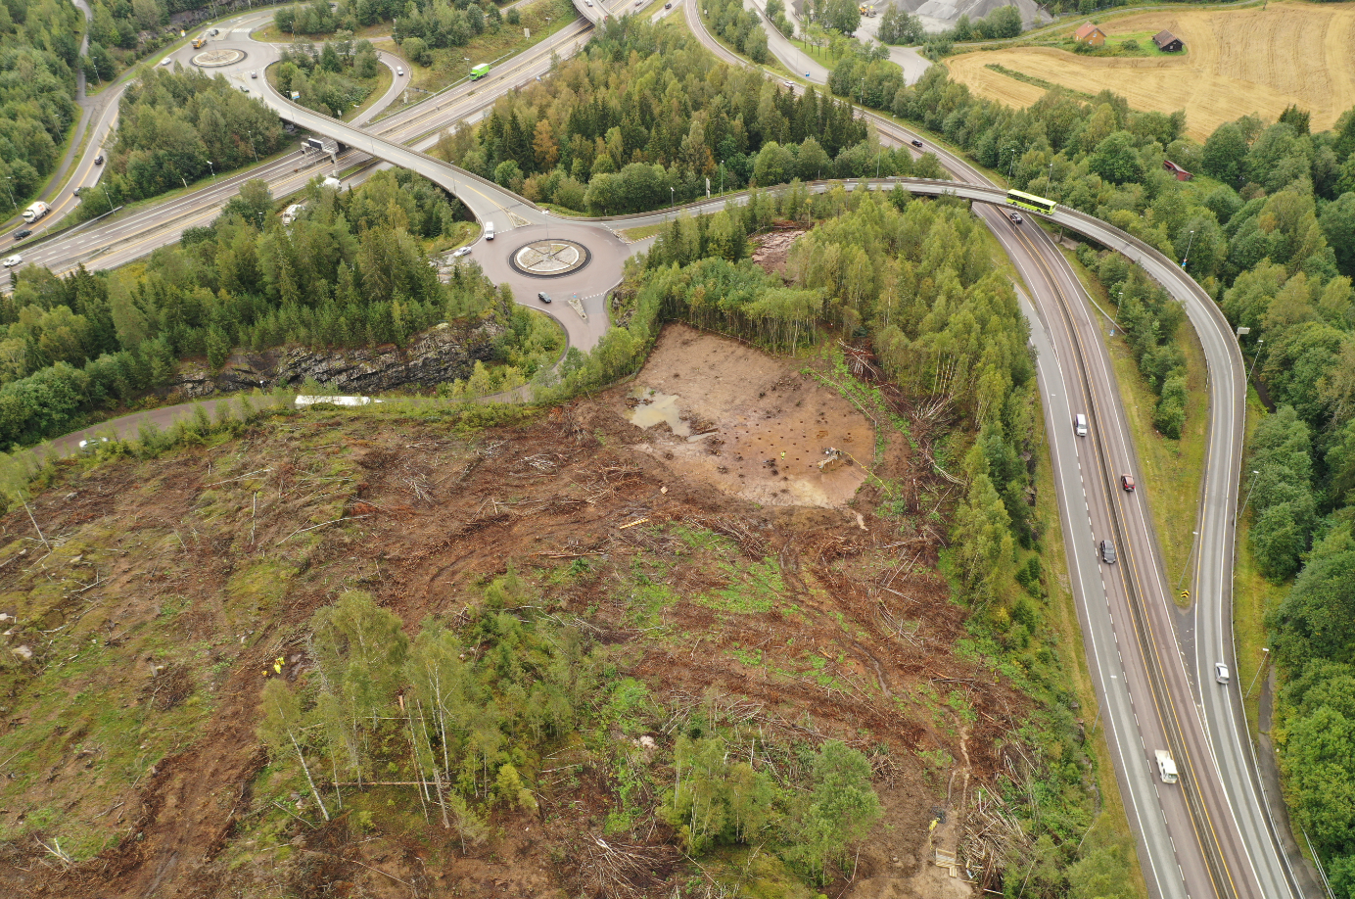
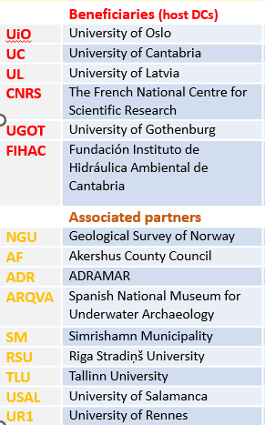
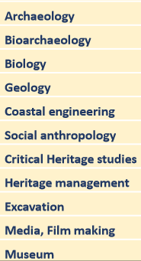
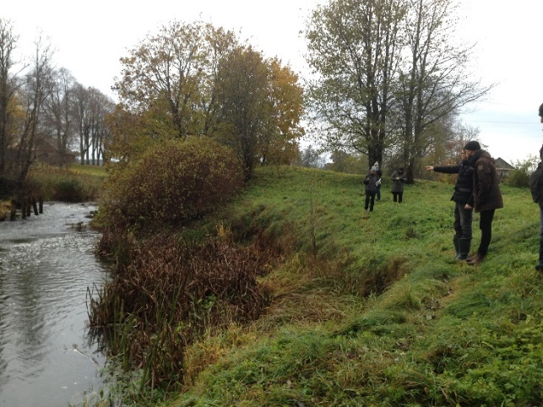
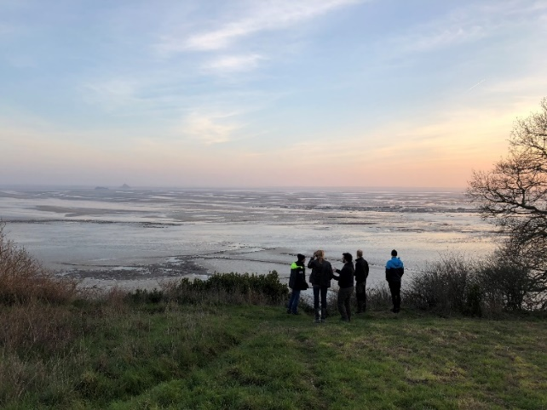
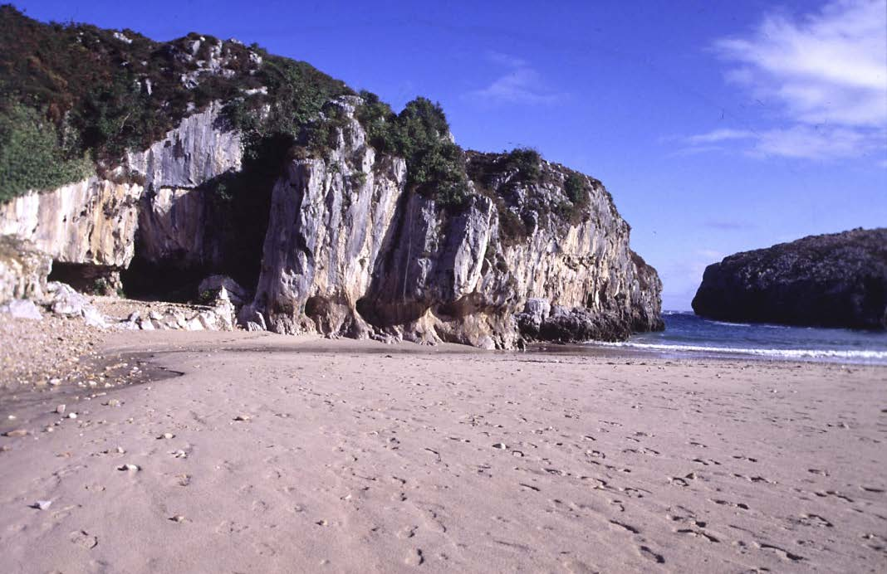
Stone Age hunter-fisher-gatherer (HFG) heritage:
Comparing diverse situations in coastal areas of Europe
INTERNATIONAL:
15 Partner institutions
Six countries:
Norway, Latvia, Estonia, Sweden, France, Spain
NGU
UiO
TLU
AF
UGOT
RSU
UL
SM
ADR
CNRS
UR1
FIHAC
UC
USAL
INTERDISCIPLINARY & INTERSECTORAL
ARQVA

Slide 5
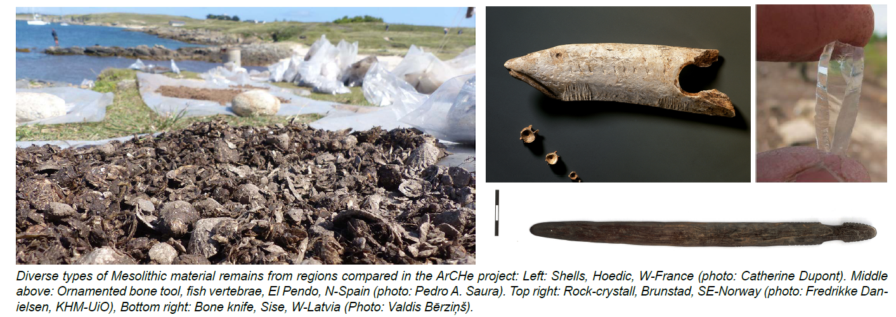
Stone Age hunter-fisher-gatherer (HFG) heritage in European coastal areas: Diverse challenges
Fragile and often only visible to the trained eye
Exposed to: - coastal erosion
- anthropogenic impact
Coastal environment diversity results in diverse preservation conditions
Interpretative regionalisation
→ HFG legacies are overlooked and therefore threatened

Slide 6
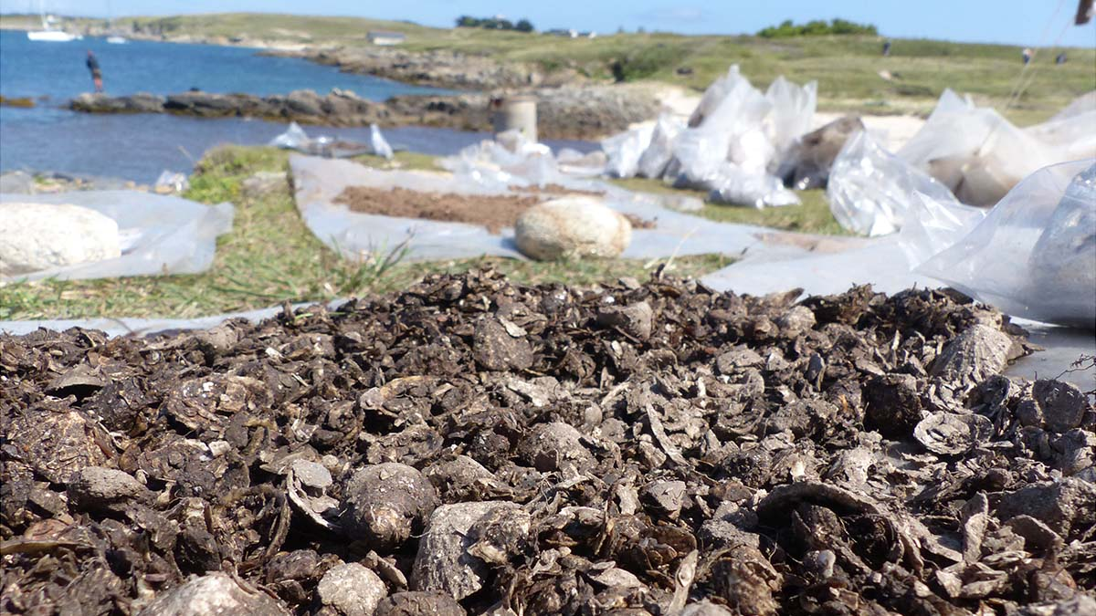
future – present – past – present – future
WP2 - Coastal territories and environmental threats
Coastal engineering, earth sciences, archaeology
N-Spain
W-France
WP3 - Dwelling in coastal areas: Places, rituals, networks and mobility
Archaeology, life sciences, spatial studies (GIS)
WP4 - Managing coastal resources
Archaeology, humanities, life sciences
Coastal HFG legacy –
exposed to diverse challenges
WP5 - Coastal Stone Age as contemporary heritage
Social anthropology, heritage studies, archaeology
S-Norway
Latvia
Interregional comparison
Illustration: Almut Schülke

Slide 7
Kelly Gibbons (DC3)
Amanda Sky (DC9)
UiO
Kevin Sleebos (DC6)
Jesper Gulliksen (DC8)
UGOT
UL
Rachel Runesson (DC10
10 Doctoral candidates (DCs),
With background from
nine countries/three continents
and diverse disciplines
Most of them paired at one institution
9 of ten recruited in August/September 2024
Giada Pirrone (DC5)
Anass Butsch (DC7)
CNRS
Jasmine Mifsud (DC2)
UC
Claudia Finocchiaro (DC4)
FIHAC
Julius J. T. Dimabayao (DC1)

Slide 8
A Social Sciences and Humanities project …
for the 2022 call (for MSCA Doctoral networks): 149 excellent doctoral programmes where chosen
Covering these fields
Engineering and ICT: 33.6%
Life Sciences: 26.2%
Chemistry: 12.8%
Environment and Geosciences: 9.4%
Social sciences and Humanities: 8.7%
Physics: 7.4%
Mathematics: 1.3%
Economics: 0.7%
see:
MSCA awards €429.4 million for doctoral programmes | Marie Skłodowska-Curie Actions (europa.eu)
101119258 – ArCHe – HORIZON-MSCA-DN-2022
2.737.416,60 €
Project period: 01.01.2024 – 31.12.2027

Slide 9
Motivation: How did we get there?

Slide 10
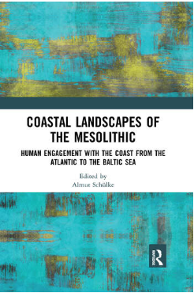

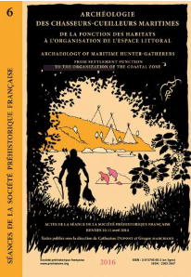
…. A little timeline …. 10 years …
Different but similar international discussions met … (SW-Europe meets N- and NE-Europe)
… the two “groups” had diverse networks from which we chose appropriate partner organisations for the DN-application …
Schülke (ed. 2020)
2013-2016
Research group ‘Steinalderens kystlandskap’ connected to development led archaeological project E18 Rugtvedt-Dørdal
2016: International workshop at MCH, UiO:
The coastal landscapes of the Mesolithic
from 2024 …
2019-2023
International research network (IRN)
PrehCOAST
(financed by CNRS)
2013
2016
2018
2020-2022
2014: Séance de la Société Préhistorique Française, Rennes, Archéologie des chasseurs-cueilleurs maritimes …
June 2019
Decision to apply
for an H2020 ITN
3x proposals
MSCA ITN (2020), DN (2021, 2022)
Dupont/Marchand (eds.) 2016

Slide 11
Composing the consortium …
Brainstorming:
How to lift our common ambition?
How to make our research relevant, thinking interdisciplinary and intersectoral?
How to meet MSCA DN criteria?
How to compile a relevant training programme?
Scouting for new partners: e.g. Social anthropology, film
→ Innovation
Core group: Existing research network in archaeology
Integrating institutions/
fields that we had worked with before, e.g.
cultural heritage management, museum
Choice of partner organisations
- Decisive for us
(apart from being relevant):
reliable, genuinely interested, responsive/communicating

Slide 12



Application process: 3 x
January 2020 (H2020), ITN
Refusal, but very constructive feedback
→ encouraging
Important: Be prepared for a lot of work for each application
(… test of stamina …)
November 2021 HORIZON Europe, DN
A lot had to be changed due to new frame programme
Refusal, but very concrete feedback about what to improve
November 2022, HORIZON Europe, DN
→ SUCCESS
- Project plan got improved each time
- Throughout application process continuity of partner organisations → a very solid consortium

Slide 13
Kelly Gibbons (DC3)
Amanda Sky (DC9)
UiO
Kevin Sleebos (DC6)
Jesper Gulliksen (DC8)
UGOT
UL
Rachel Runesson (DC10
10 Doctoral candidates (DCs),
With background from
nine countries/three continents
and diverse disciplines
Most of them paired at one institution
9 of ten recruited in August/September 2024
Giada Pirrone (DC5)
Anass Butsch (DC7)
CNRS
Jasmine Mifsud (DC2)
UC
Claudia Finocchiaro (DC4)
FIHAC
Julius J. T. Dimabayao (DC1)

Slide 14

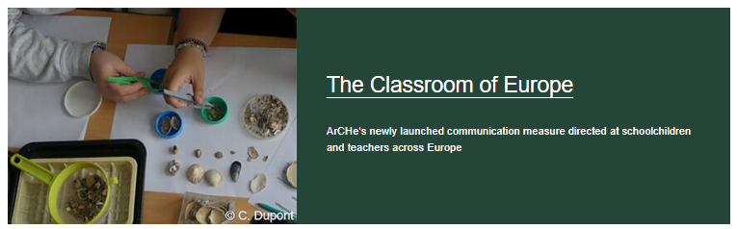
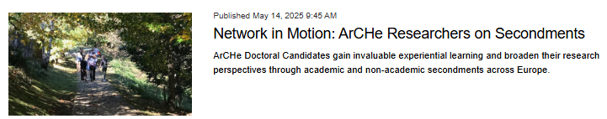
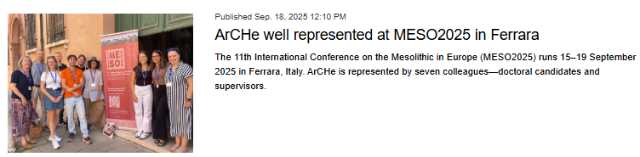
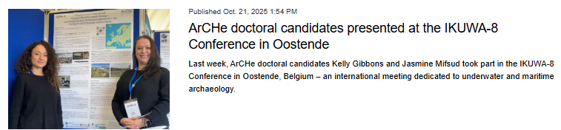
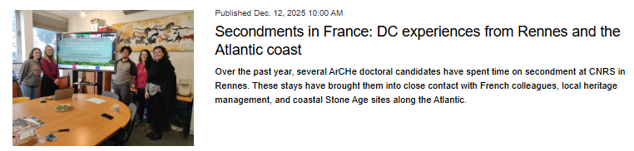
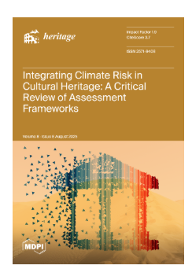
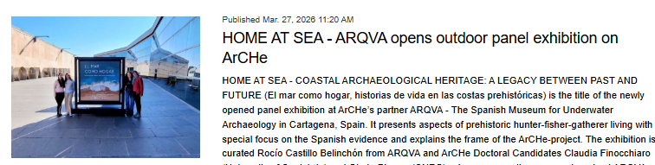
Communication
Joint Training Events
Second
ments
Individual research projects
Dissemination
from: www.arche.uio.no

Slide 15
Recruitment of DCs – some thoughts:
Advantage: a closely connected group of DCs
Makes being part of an ambitious DN much more fun
Creating a joint identity
Joint Training Events: the DCs get trained together interdisciplinarily and intersectoral approaches (some are always more familiar with a topic/field than others)
→ good for fostering mutual support, understanding of the network’s overall ambitions and goals and for creating synergies
Process of recruitment is immensely important
(and very complex and time intensive)

Slide 16
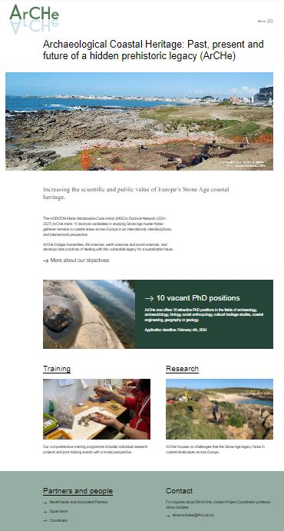
Semi-centralized recruitment – some experiences:
Coordinator and beneficiaries:
Common recruitment strategy at all beneficiaries
Content of the DC job advertisements at each beneficiary was coordinated
→ setup and content of advertisement, DN background and expectations, link to project website
Launch of project website & launch of 10 DC positions (in six institutions and five countries!) on the same day
website described all the DC projects and expectations to DCs in the network (training, secondments, communication …); local DC job advertisements accessible via project website
→ website was addressed at potential applicants
→ DC-group started around the same time (August/September 2024)
→ DC-group worked together and followed each other from the start
→ good for project identity and synergies
ArCHe recruitment website

Slide 17
Some lessons learned …
The project is running
However: Challenging phases, e.g.
Directly after we got offered the grant: little prepared regarding the strict timeline towards signature of the Grant Agreement
→ Advice: be prepared in case you get the grant
Before the official start of the action: Encompassing administrativ tasks
→ a lot of adminstrative work:
  signing of the Grant agreement, drafting of Consortium agreement, preparing and following up the semi-centralized recruitment process, develop project website, ….
    → Advice: make sure to administrative help (HR, economy …) in place right after one has got the grant offer (and even better: before that) ….

Slide 18
Lessons learned …
Mobility of the DCs during the project:
secondments:
- great opportunity, very important for learning and mutual understanding, exchange and synergies → DCs meet in different constellations in differing settings and for longer times …
- however, this can become quite exhausting, as DCs in some phases are not at their home institution for many months → has consequences for private life, place of living, well-being etc.
  → Advice:
  think relevance of academic and non-academic secondments when you plan the project
  Think feasible timing not least regarding length of secondments
  Give administrative support to the DCs for preparing the secondment, at the Coordinator, but especially also at the secondment entities (e.g. help with finding accommodation, provide important information/welcome leaflet, include in social settings etc.)

Slide 19
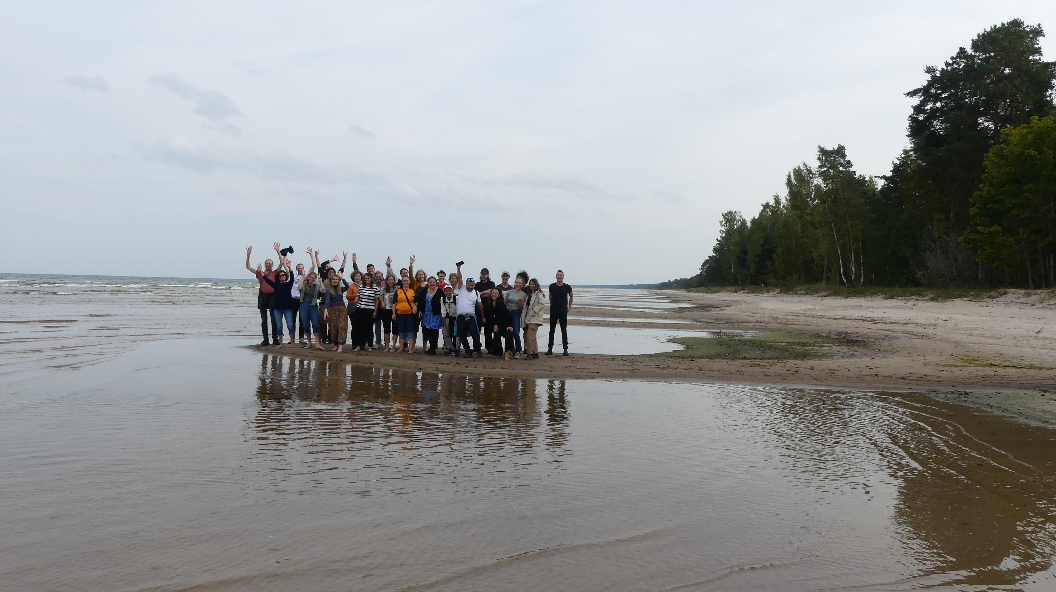


Photo: Catherine Dupont, CNRS
Thank you for your attention!
Follow us on www.arche.uio.no

Slide 20













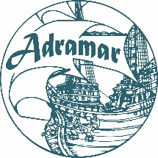
Funded by the European Union under the Horizon Europe Marie Skłodowska‑Curie Actions (Grant Agreement No. 101119258).
Views and opinions expressed are however those of the author(s) only and do not necessarily reflect those of the European Union or the granting authority. Neither the European Union nor the granting authority can be held responsible for them.

